Slide 1
CS F320 Foundations of data scienCe
Assignment #2 Presentation Template
Group 10

Slide 2
Problem Statement
What makes someone buy a room or a house? Various factors like how hot or cool the room is, or how well the room is lit affects that decision.
The ‘Occupancy detection dataset’ included data, which is to be used to predict whether a room will be occupied or not.
The problem asks us to build a model which will analyze data factors like temperature, humidity, light, CO2 content etc. present in a room and predict whether the room will be occupied or not.

Slide 3
Datasets used
The ‘Occupancy Detection Data Set’ used was derived from the UCI machine learning repository. It includes three files:
datatraining.txt
datatest.txt
datatest2.txt

Slide 4
Data Description
The data in all the three files include:
date time year-month-day hour:minute:second Temperature, in Celsius Relative Humidity, % Light, in Lux CO2, in ppm Humidity Ratio, Derived quantity from temperature and relative humidity, in kgwater-vapor/kg-air Occupancy, 0 or 1, 0 for not occupied, 1 for occupied status

Slide 5
Time series analysis – classification techniques
Two Classifiers
We divide this demonstration into two parts to train a model that predicts whether a room is likely to get occupied or not for any new given value.
Using Logistic Regression Classifier using an inbuilt function.
Using a built in Neural Network function.

Slide 6
Techniques used for occupancy detection
Since occupancy detection can be though of as a classification problem where the dependent variable is categorical, we can easily use logistic regression to predict the state of occupancy of a room, which depends on many factors.
To achieve this we have used the glm function and the binomial family for the classification and evaluated the R-squared value.

Slide 7
Preprocessing
Data preprocessing:
We combined the three datasets into a single huge dataframe. After that, the data in the above dataset had various ranges and so it was required to perform feature scaling.
The data was further split into two parts for training and testing by random sampling.
A logistic regression model and a neural network were fitted on the training data. The testing data was used to evaluate the performance of the models.

Slide 8
Details of Techniques used for occupancy detection
LOGISTIC REGRESSION APPROACH
We can see how ‘correlated’ a feature is to each other by plotting a ‘Correlation Graph’ using the pairs.panels function available in the ‘psych’ package.
So, after splitting data into training and test set, Correlation graph was plotted.
After this, correlation coefficients were analyzed and three models were built according to changing relevancy of factors according to their correlation coefficients.

Slide 9
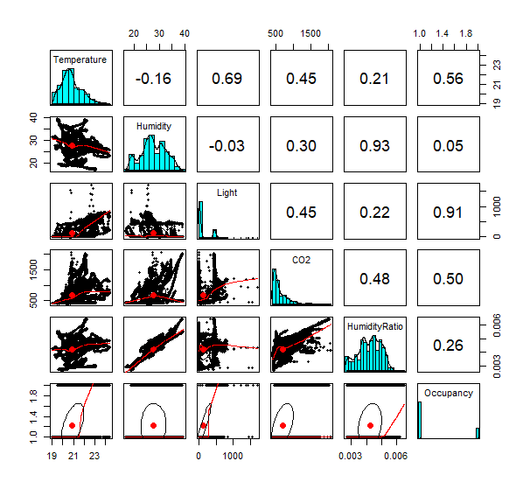

CORRELATION GRAPH

Slide 10
3 models were built which were:
Model using all variables.
Model using Light, CO2 and Temperatures which have corr coeffts >=.5
Modeling the problem through only cadence levels because Light and Occupancy have highest correlation.
And, then these model were used for predicting occupancy of rooms using the sample of test data.

Slide 11
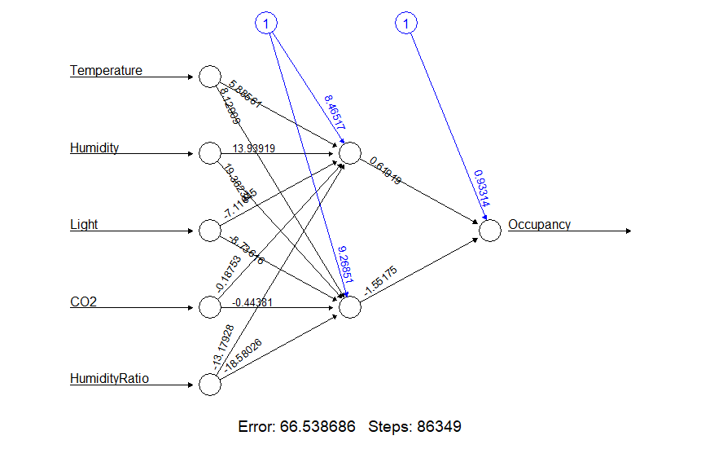
NEURAL NETWORK APPROACH
We trained a neural network on the training data using the neuralnet function from the neuralnet package. The resultant trained network is shown below.
We then predicted Occupancy Status using the predict_testNN function from the same package.

Slide 12
Results/findings & Comparisons (in the form of graphs & tables)
The logistic regression model 1 trained for all variables gave the following results.
1. Accuracy=98.92%(Total correct Predictions/Total Predictions)
2.Confusion MATRIX
Precision=95.91 Recall=99.56
F1-Score=2PR/(P+R)=97.70 %
 | PREDICTED=YES | PREDICTED=NO
ACTUAL=YES | 1573 | 7
ACTUAL=NO | 67 | 5206

Slide 13
Results/findings & Comparisons (in the form of graphs & tables)
The logistic regression model 2 trained for variables Light,CO2,Temperature gave the following results.
1. Accuracy=98.89%(Total correct Predictions/Total Predictions)
2.Confusion MATRIX
Precision=96.07 Recall=99.24
F1-Score=2PR/(P+R)=97.629 %
 | PREDICTED=YES | PREDICTED=NO
ACTUAL=YES | 1568 | 12
ACTUAL=NO | 64 | 5209

Slide 14
Results/findings & Comparisons (in the form of graphs & tables)
The logistic regression model 3 trained only for variable Light gave the following results.
1. Accuracy=98.89%(Total correct Predictions/Total Predictions)
2.Confusion MATRIX
Precision=95.79 Recall=99.56
F1-Score=2PR/(P+R)=97.63 %
 | PREDICTED=YES | PREDICTED=NO
ACTUAL=YES | 1573 | 7
ACTUAL=NO | 69 | 5204

Slide 15
Results/findings & Comparisons (in the form of graphs & tables)
The Neural Network model gave the following results.
1. Accuracy=98.92%(Total correct Predictions/Total Predictions)
2.Confusion MATRIX
Precision=95.91 Recall=99.56
F1-Score=2PR/(P+R)=97.70 %
 | PREDICTED=YES | PREDICTED=NO
ACTUAL=YES | 1573 | 7
ACTUAL=NO | 67 | 5206

Slide 16
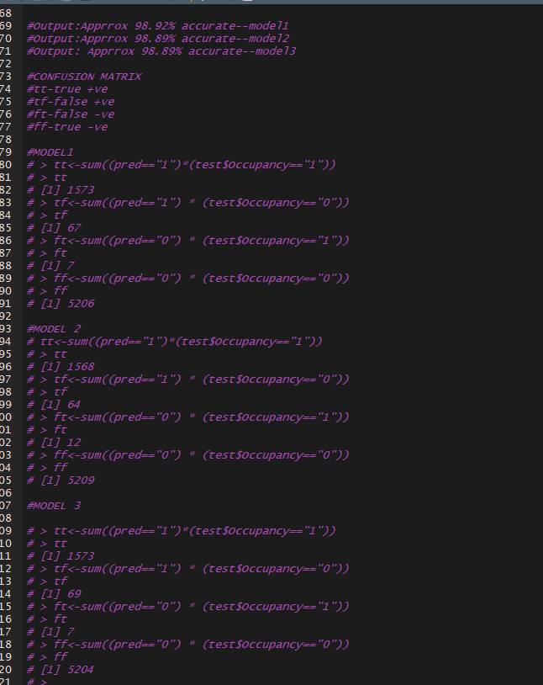
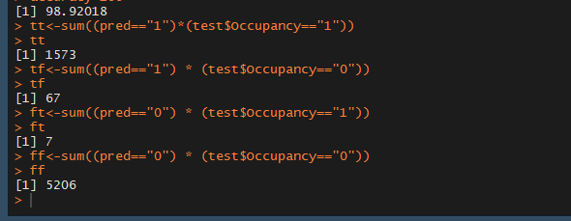

Slide 17
From the results we can see that a more computationally taxing Neural Network model and a more simplistic Logistic Regression model arrived at similar answers. From this we can conclude that for the given time series data, analysis through Logistic Regression will make our jobs much easier and faster because a Neural Network training will take longer.
Also we can conclude that Light cadence levels are the major indicators of room Occupancy status.

